Slide 1
Safestreets
Software Engineering II Project 2019-2020
Pozzi Matteo
Sacco Sara
Ventura Andrea
Prof. Matteo Rossi

Slide 2
Goals
[G3] Allow Authorities to evaluate submitted reports and Citizens to visualize accepted ones with limited information;
[G8] Allow an Authority to link issued traffic tickets to relative Citizens reports;

Slide 3
Difference between MobileApp and WebApp
Citizens can notify a violation only from the mobile app;
Authorities can’t generate ticket from the mobile app;
Authorities can notify an accident only from the web app;

Slide 4
Alloy Model
User authentication: username, fiscal code;
Report management:
Each report’s status must be one among evaluating, accepted, refused;
Each report is saved in the report history of the citizen who submitted it;
Each report is saved in the report list of the municipality of the corresponding area;
If the report has status accepted, it must be saved in the list of accepted reports;
If the report has status accepted, a ticket is automatically created;
Area identification:
Singular locations which can be simple, or marked as unsafe or high frequency violations;
Constraints for area identification have been simplified.

Slide 5
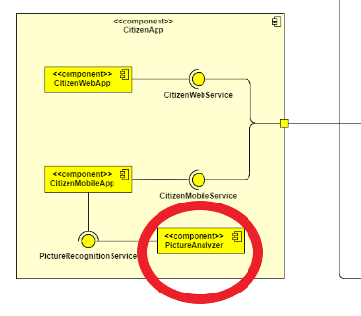
Analyzing pictures
Located on client device
Reduced avoidable server workload
Clients are independent: each client manages its own pictures
When a picture is sent to the server it doesn’t have to be checked again
It can be immediately stored
Saved computational resources

Slide 6
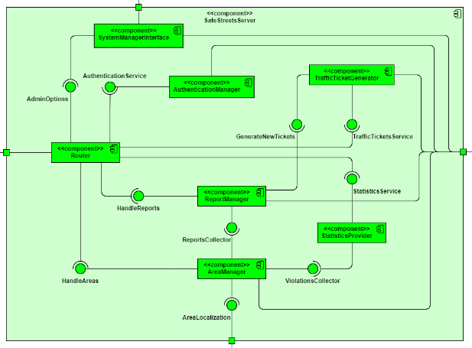
Server components
One component for each handled resource
Reports, Tickets, Areas, Statistics, Users management
Functionalities grouped by resources…
… each functionality can be easily found…
… more maintainable and scalable system

Slide 7
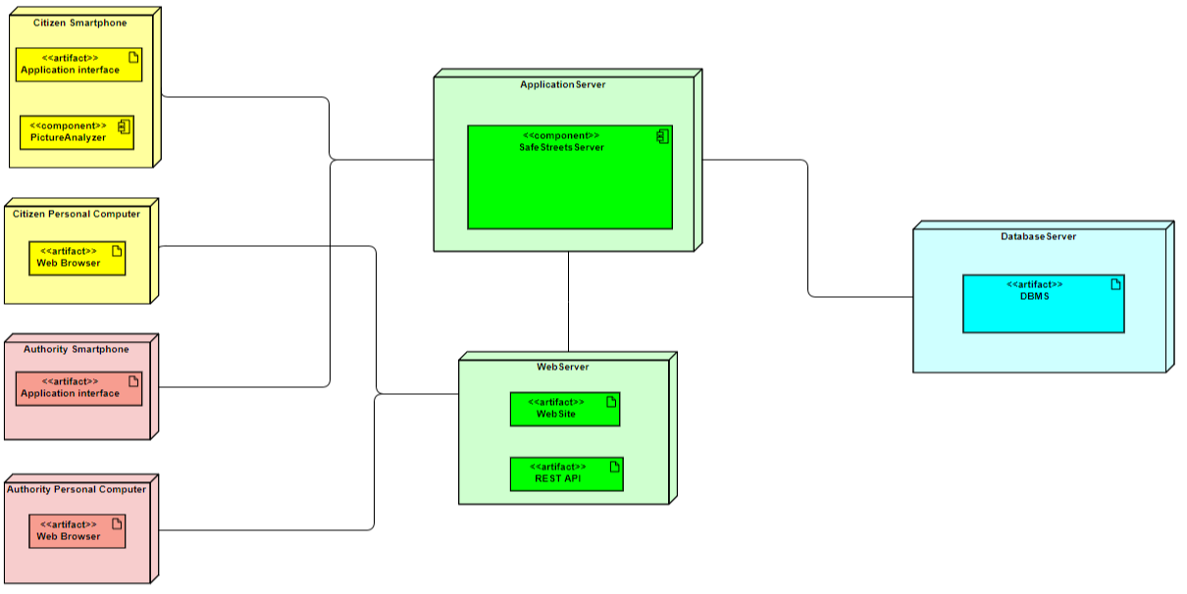
Components deployment
Three tier architecture
(Presentation+Application) + Application + Data
Web and application servers to handle requests
Relational DBMS to store meaningful data
Replication and load balancing mechanisms between tiers
Improved availability and execution time

